Slide 1
Ohio Health Improvement Zones:
New Approaches to Achieving Health Equity
Speakers:
Learning Objectives:
Identify the factors that drive health outcomes and disparities in Ohio.
Articulate ways that the Ohio Health Improvement Zone projects address both the root causes of health disparities and communities’ immediate health related social needs.
Describe the importance of, and strategies to perform community-centered engagement.
Speakers for this session have no disclosures to report.
Notes:
Learning Objectives for this session are noted here and speakers have no disclosures to report.

Slide 2

Ohio Health Improvement Zones
New Approaches to Achieving Health Equity
October 21, 2022
Carrie Almasi
Health Policy Institute of Ohio
calmasi@healthpolicyohio.org
Copyright © 2021 Health Policy Institute of Ohio. All rights reserved.
Copyright © 2022 Health Policy Institute of Ohio. All rights reserved.

Slide 3

Mission
To advance evidence-informed policies that improve health, achieve equity, and lead to sustainable healthcare spending
Copyright © 2022 Health Policy Institute of Ohio. All rights reserved.

Slide 4
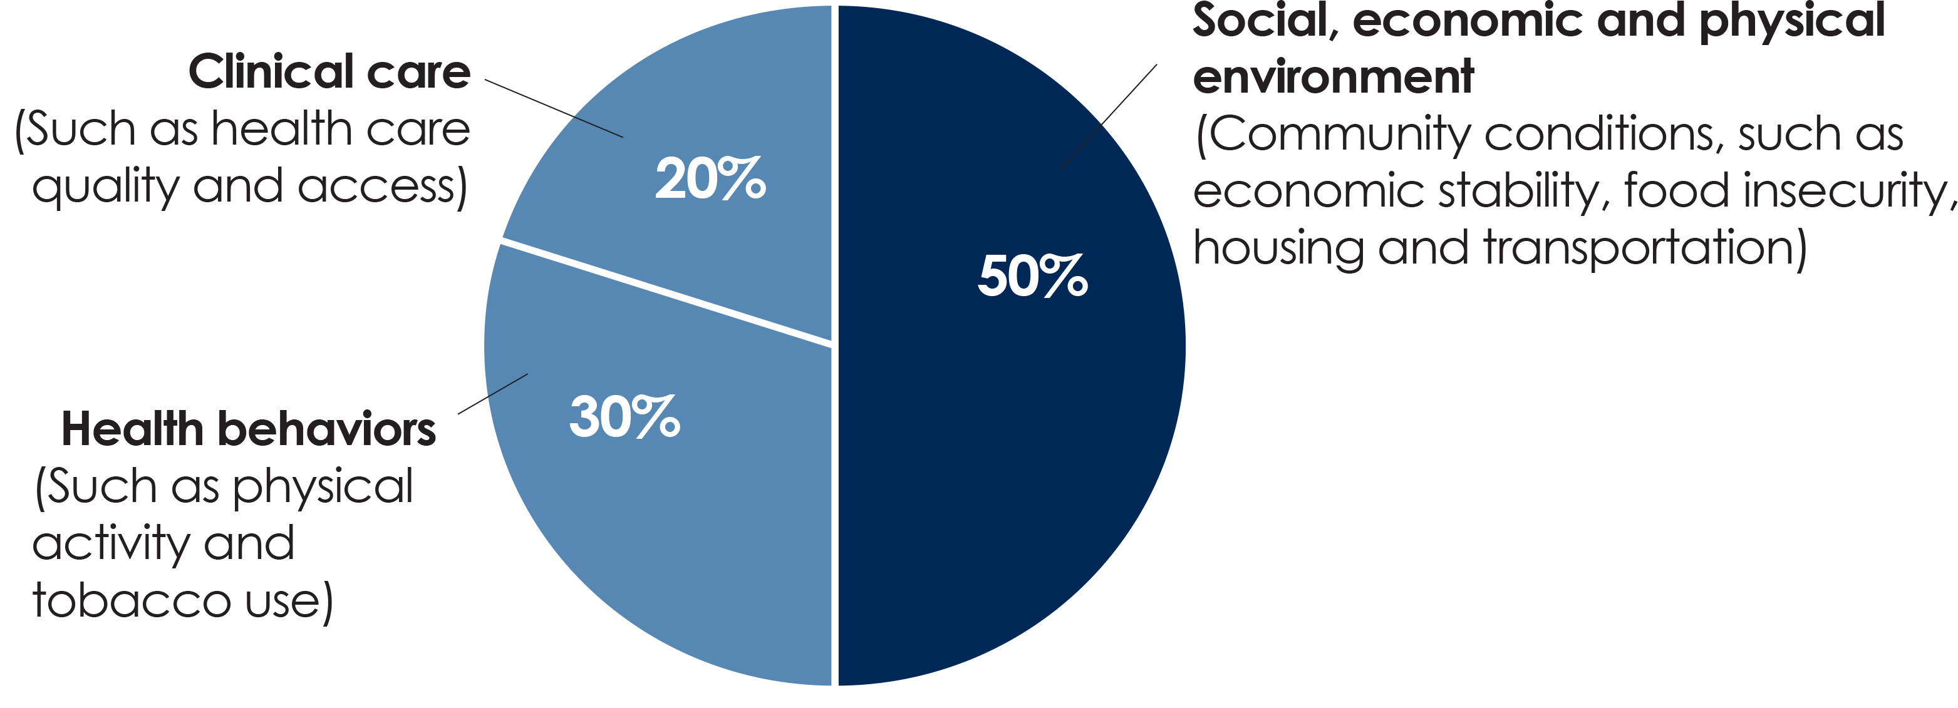
Modifiable factors that impact health
Social, economic and physical environment
(Community conditions, such as economic stability, food insecurity, criminal justice, housing and transportation)
Underlying drivers of inequity
Racism and other forms of discrimination (i.e., ableism, ageism, sexism, xenophobia, homophobia, etc.), trauma, exposure to violence, toxic stress, stigma
Source: Booske, Bridget C. et. Al. County Health Rankings Working Paper: Different Perspectives for Assigning Weights to Determinants of Health. University of Wisconsin Public Health Institute, 2010.
Copyright © 2022 Health Policy Institute of Ohio. All rights reserved.

Slide 5
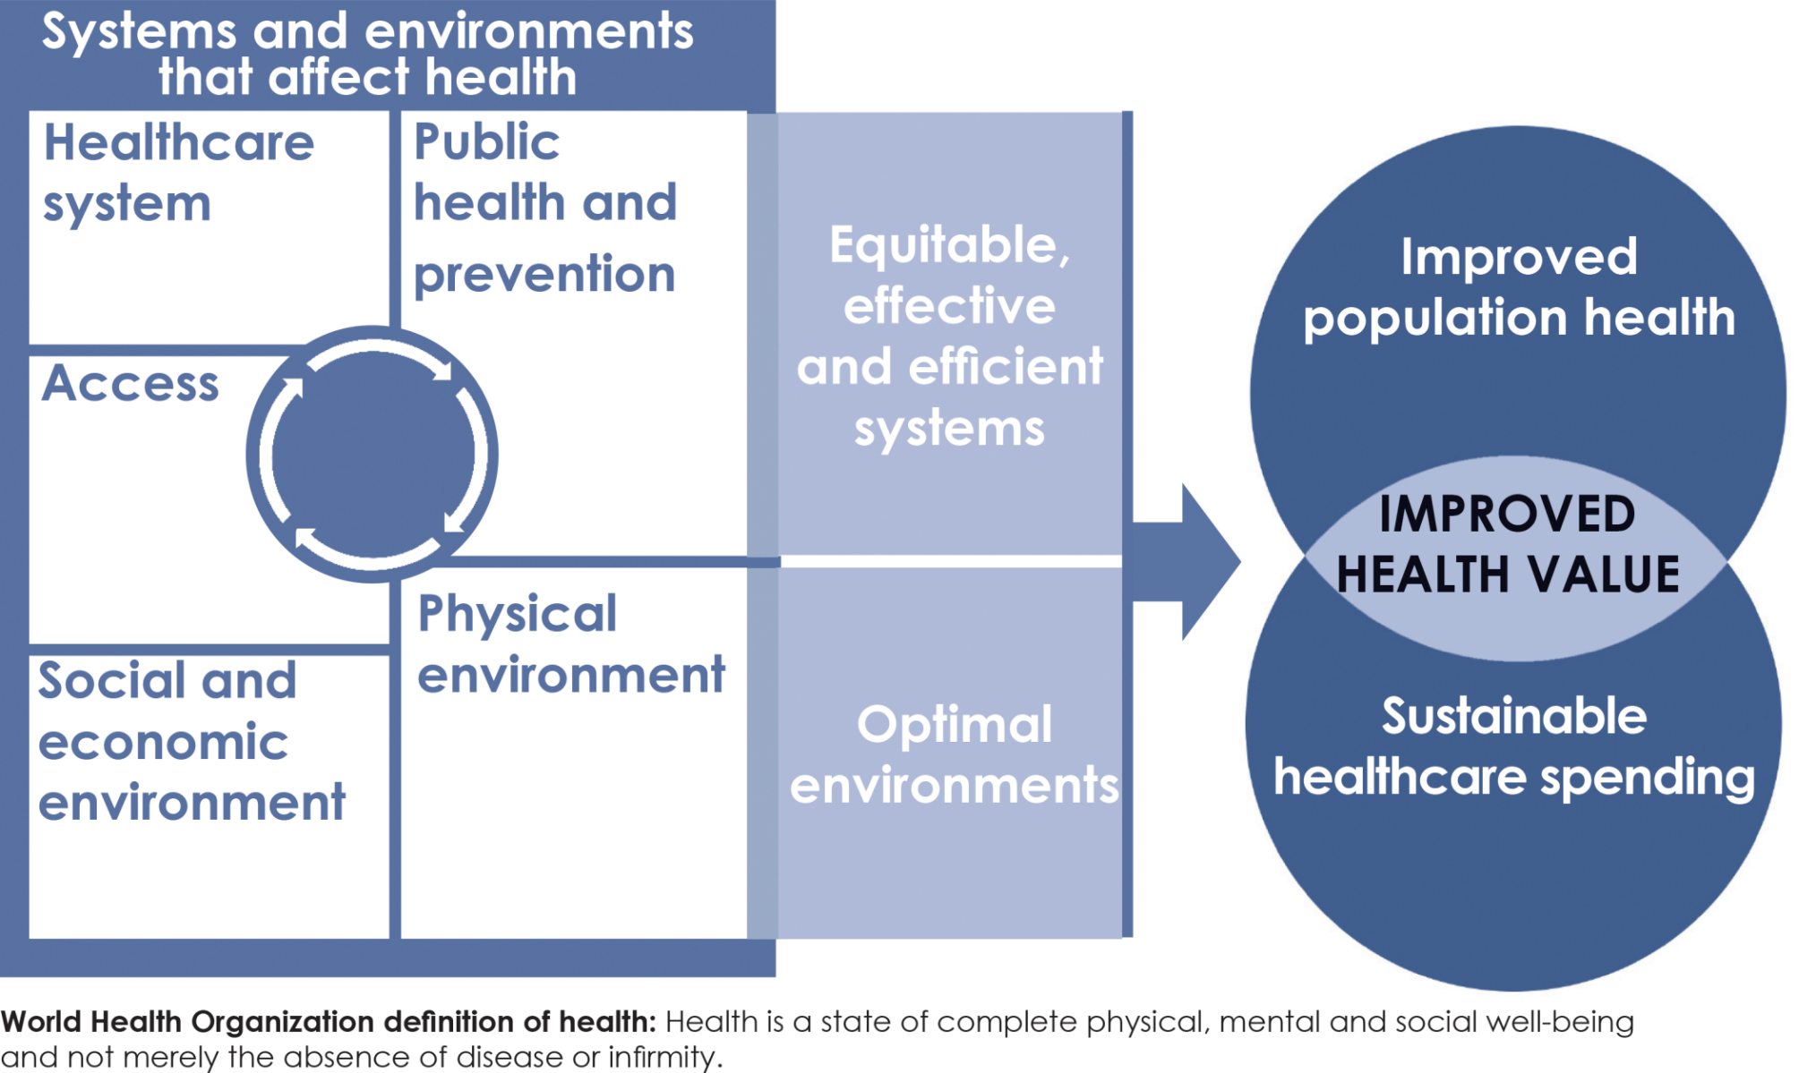
Pathway to improved health value
Copyright © 2022 Health Policy Institute of Ohio. All rights reserved.

Slide 6

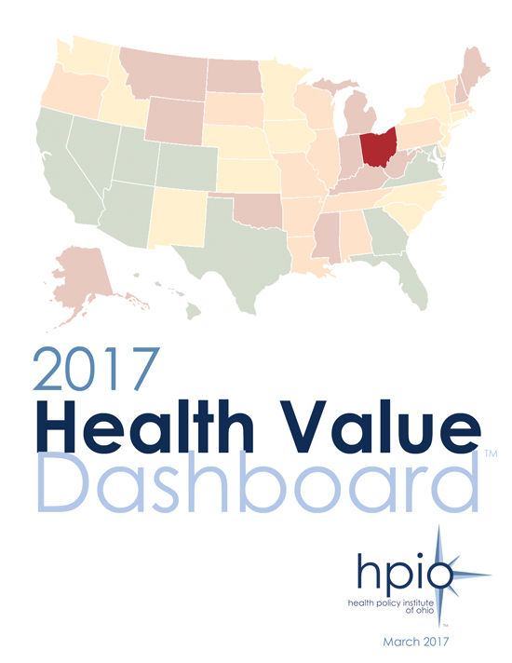

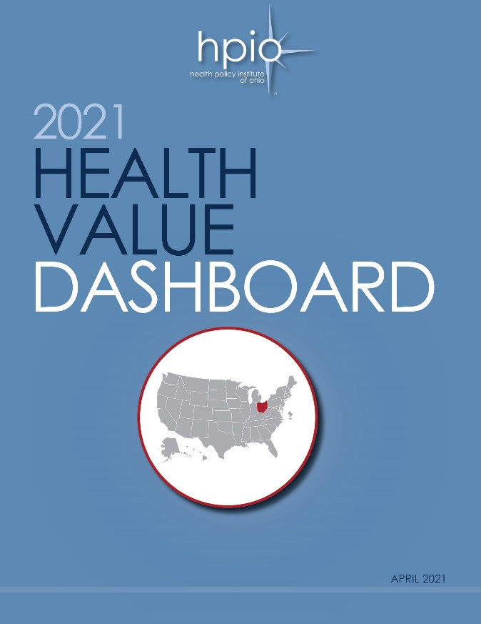
Coming soon
Copyright © 2022 Health Policy Institute of Ohio. All rights reserved.

Slide 7
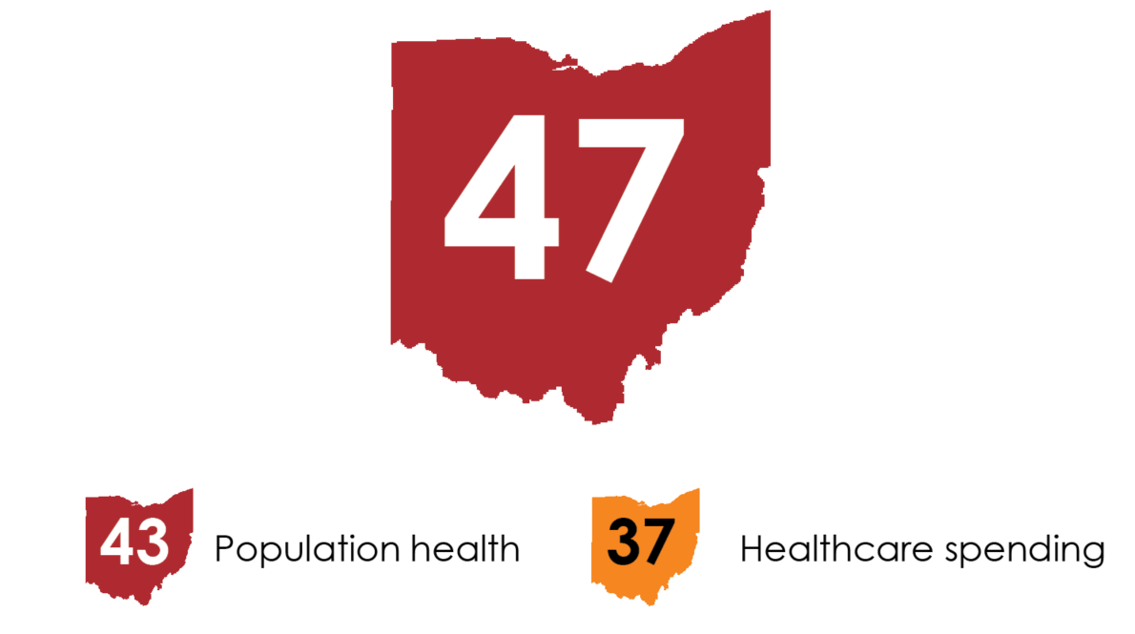
Health value in Ohio
Copyright © 2022 Health Policy Institute of Ohio. All rights reserved.
Notes:
Now here the results from the 2021 Dashboard that we released today:
Ohio ranks 47 out of 50 states and the District of Columbia on health value.
We rank 43rd on population health and 37th on healthcare spending.
This means that Ohioans continue to live less healthy lives and spend more on health care than people in most other states.

Slide 8
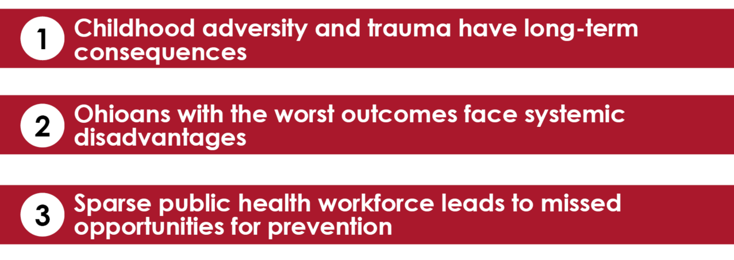
Why do we rank poorly
on health value?
Copyright © 2022 Health Policy Institute of Ohio. All rights reserved.

Slide 9
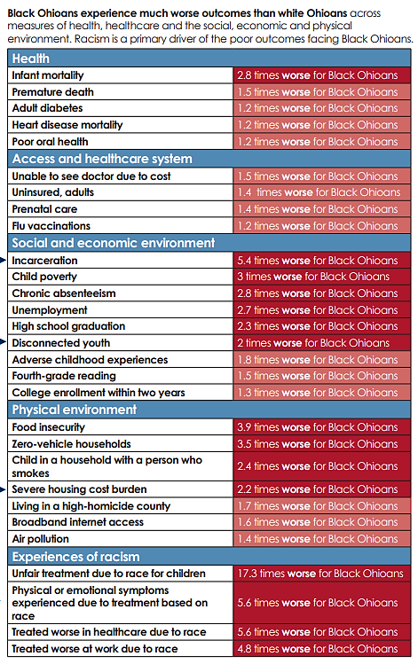
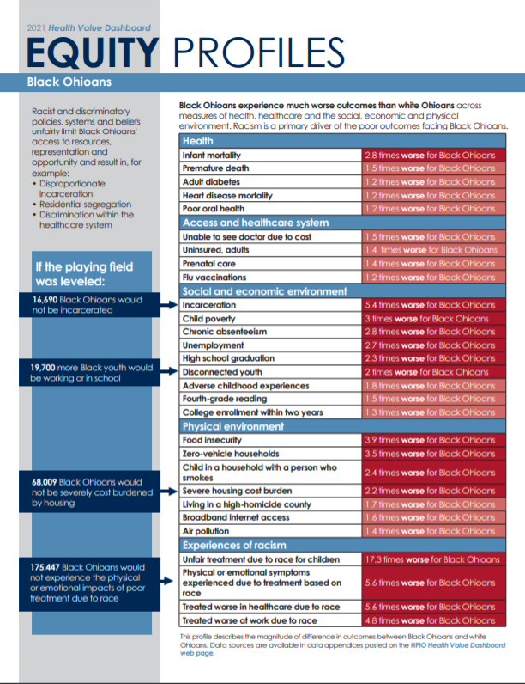
Copyright © 2022 Health Policy Institute of Ohio. All rights reserved.

Slide 10


How policies can affect community conditions and health
Housing policies
(redlining, predatory lending)
Neighborhood segregation, concentrated poverty and disinvestment
Harmful community conditions
(food deserts, unsafe/ unstable housing)
Health disparities
Copyright © 2022 Health Policy Institute of Ohio. All rights reserved.

Slide 11
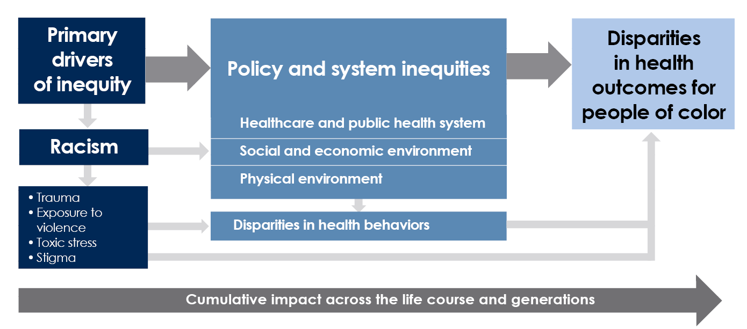
Connection Between Racism and Health
Copyright © 2022 Health Policy Institute of Ohio. All rights reserved.

Slide 12
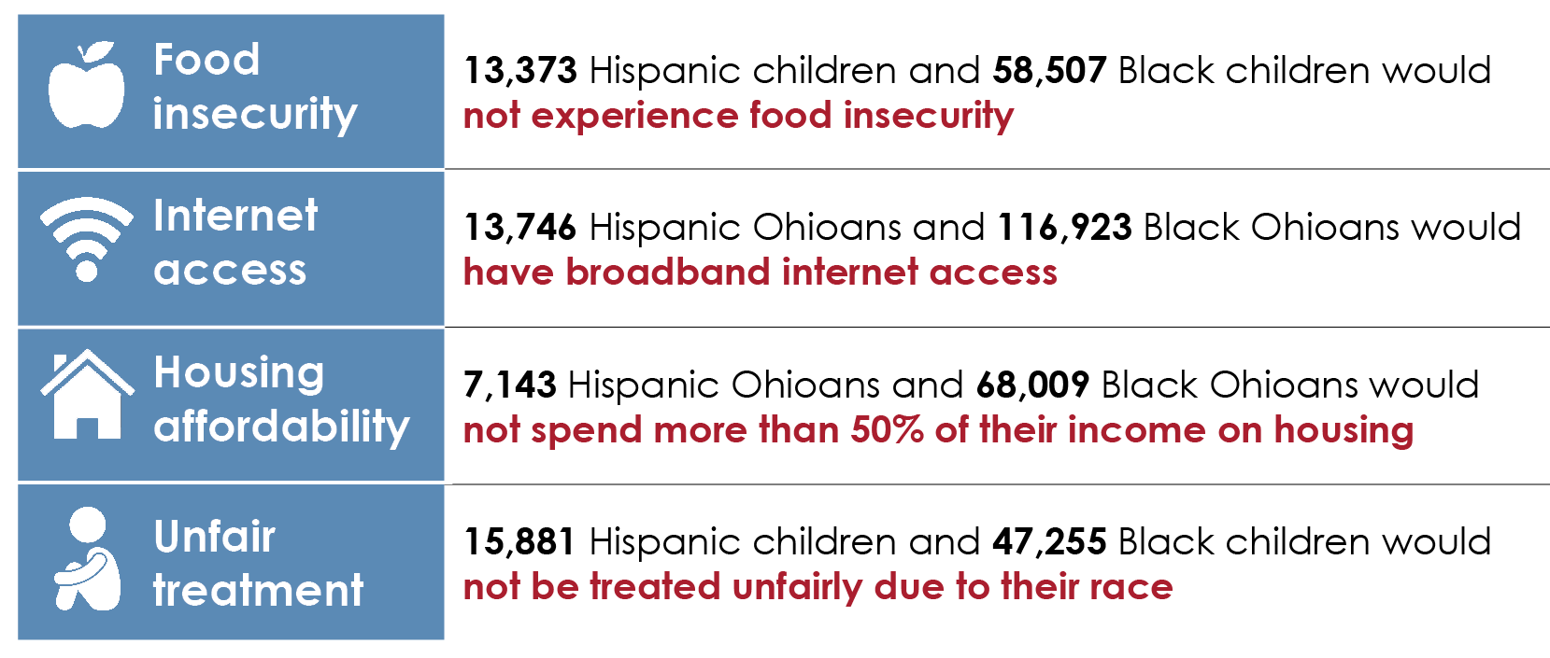
If the playing field was leveled...
Source: Health Policy Institute of Ohio. 2021 Health Value Dashboard Equity Profiles. April 2021.
Copyright © 2022 Health Policy Institute of Ohio. All rights reserved.

Slide 13
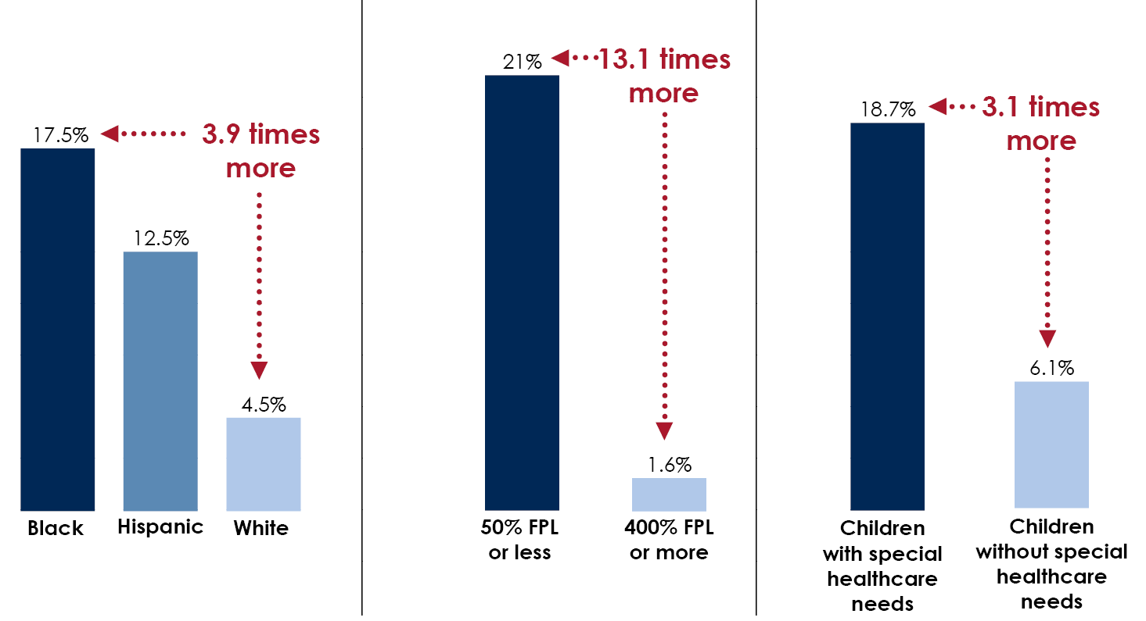
Food insecurity
Families that "sometimes" or "often" cannot afford enough to eat Ohio, 2016-2019
By race/ethnicity
By income
By disability status
Source: Dr. Ani Ruhil, Ohio University Voinovich School of Leadership and Public Affairs, analysis of National Survey of Children's Health
Copyright © 2022 Health Policy Institute of Ohio. All rights reserved.

Slide 14
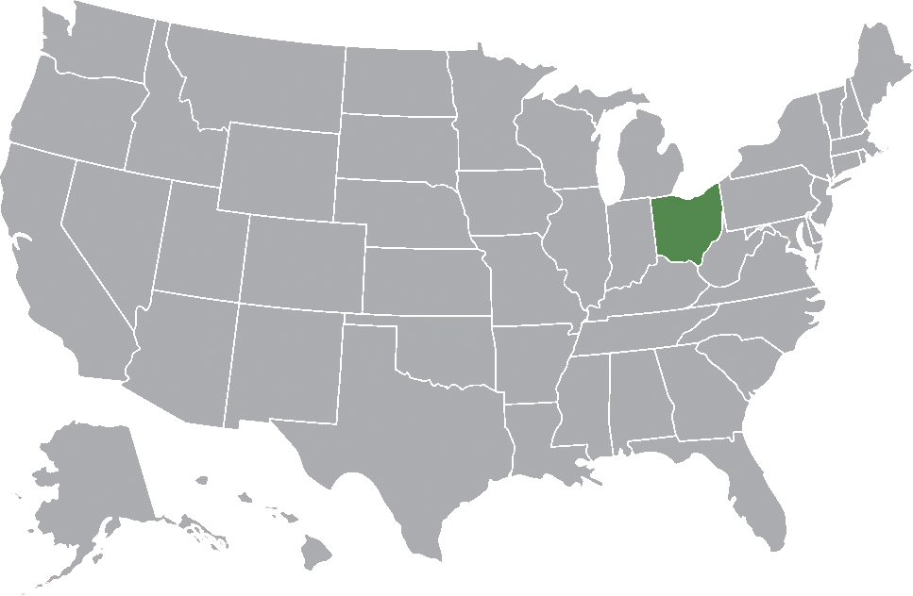
Improvement is possible
Copyright © 2022 Health Policy Institute of Ohio. All rights reserved.

Slide 15
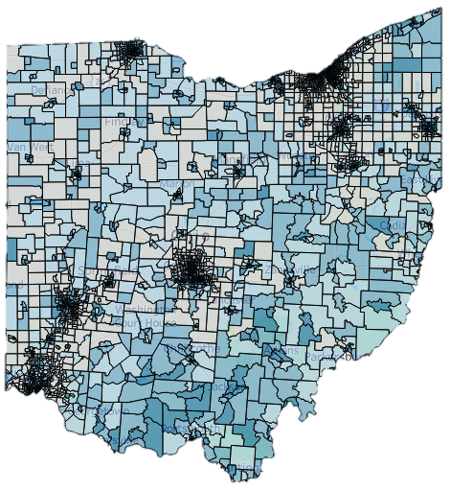
Ohio Health Improvement Zones
Source: Ohio Department of Health
Copyright © 2022 Health Policy Institute of Ohio. All rights reserved.

Slide 16


Connect with us
Social
Email
@HealthPolicyOH
linkedin.com/healthpolicyohio
HPIO mailing list (link on our homepage, www.hpio.net)
Ohio Health Policy News (healthpolicynews.org)
Carrie Almasi
Health Policy Institute of Ohio
calmasi@healthpolicyohio.org
www.hpio.net
Copyright © 2022 Health Policy Institute of Ohio. All rights reserved.
Notes:
Twitter logo downloaded from https://about.twitter.com/en_us/company/brand-resources.html
Facebook logo downloaded from https://en.facebookbrand.com/assets/f-logo

Slide 17
Ohio Health Improvement Zones
Shelby McGhee, MPH
Associate Director of Health and OHIZ Project Manager
United Way of Greater Cleveland

Slide 18
Outline
What are Ohio Health Improvement Zones?
Our Project
Progress to Date and Next Steps

Slide 19
What are Ohio Health Improvement zones?
Developed by Ohio Department of Health to “provide flexible funding to establish or expand place-based initiatives seeking to address social determinants of health and improve healthy behaviors of residents through meaningful community engagement and cross sector collaboration”
Investing $6.89M in 26 projects across Ohio
    Four projects in Cuyahoga County
Modeled after Rhode Island’s Health Equity Zones ($30M+ invested since 2016)

Slide 20
What are Ohio Health Improvement zones?
Census-tract level
Social Vulnerability Index score > 0.75
  Represents vulnerability to “human suffering and financial loss in a disaster”
  Comprises fifteen indicators in four themes:
      Socioeconomic status
      Household composition and disability
      Minority status and language
      Housing and transportation

Slide 21
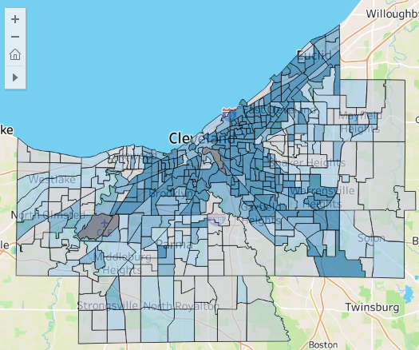
What are Ohio Health Improvement zones?
SVI Scores by Census Tract, Cuyahoga County
Darker census tracts = higher SVI
Strong association with redlining and history of disinvestment
For ODH funding, tracts must be contiguous
Source: Ohio Department of Health, https://odh.ohio.gov/know-our-programs/health-equity/health-improvement-zones

Slide 22

Our Project – Inception
Burten, Bell, Carr Development, Inc. planned to conduct neighborhood-level Community Health Needs assessments, but had a funding gap
United Way runs 211, a crucial social service referral program, but is looking for ways to make referral better
Better Health Partnership runs Pathways Hub and has a stake in improved referral and navigation for clinical partners

Slide 23
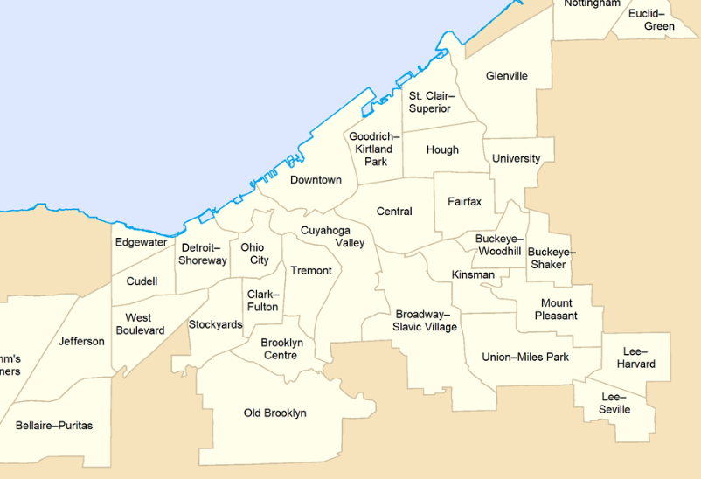
Our Project
Neighborhoods: Central, Kinsman, and Buckeye
Total funding: $300,000
Timeline: July 2022 – May 2023

Slide 24
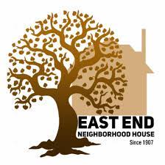



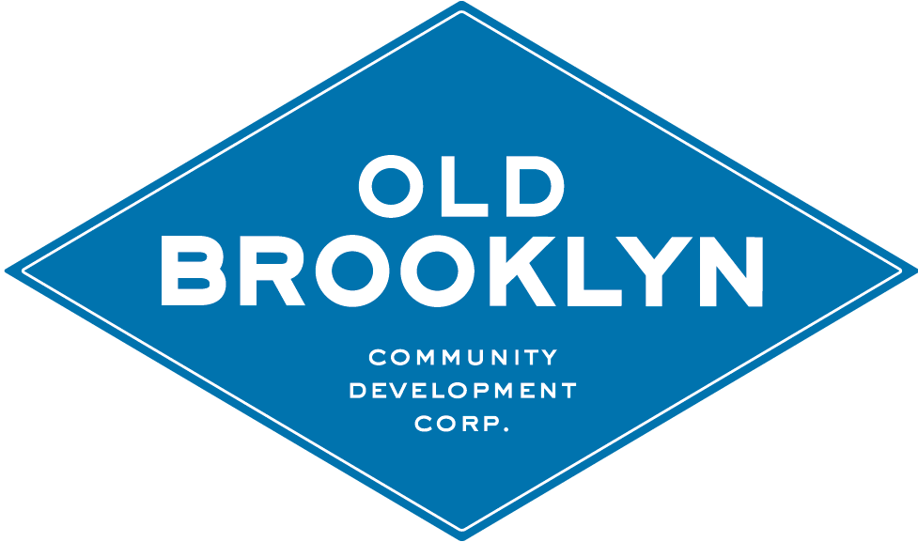

Our Project - Partners
Notes:
I think about these partners in three buckets: the core team, the planning team, and the implementation team.
We’re working to identify other community-based organizations to partner with, which I’ll go into more later. And of course, our partners are the residents of the Central, Kinsman, and Buckeye neighborhoods.

Slide 25
Our Project – activity 1
Community Engagement and Assessment
Focus neighborhoods: Central, Kinsman, and Buckeye
Funding: $100,000
Conduct neighborhood-level Community Health Needs Assessments
Facilitate resident listening sessions to understand experiences with referral and navigation
Crosswalk neighborhood plans with other local and county CHNAs to identify common themes

Slide 26
Our Project – activity 2
Strategy Implementation and Collaborative Quality Improvement
Focus neighborhoods: Central, Kinsman, and Buckeye
Funding: $200,000
Embed Community Health Workers in trusted community spaces to provide navigation of health-related social needs
Conduct referral and navigation quality improvement processes in partnership with community-based organizations
Convene health systems to create recommendations for mitigation of social needs through referrals in clinical settings

Slide 27

Progress to Date
Activity 1
Survey is ongoing
Resident listening sessions are being planned

Slide 28

Progress to Date
Activity 2
First CHW embedded at Friendly Inn and East End in October
Pursuing up to two additional CBO partners
Creating data sharing processes with QI partners
    Are referrals going to CBOs:
        Appropriate
        Eligible
        Creating positive outcomes

Slide 29
Next Steps
Activity 1
Conduct listening sessions with residents
Analyze findings from the community survey
From survey findings, re-engage residents in an action planning process
Activity 2
Receive QI data from CBO partners
Strengthen referral and navigation processes
Convene clinical partners

Slide 30
Thank you
For questions, email Shelby McGhee at smcghee@unitedwaycleveland.org

Slide 31


Ohio Health Improvement Zone Project
The importance of, and strategies to perform community-centered engagement
Sherita Mullins
Director of Supportive Services

Slide 32
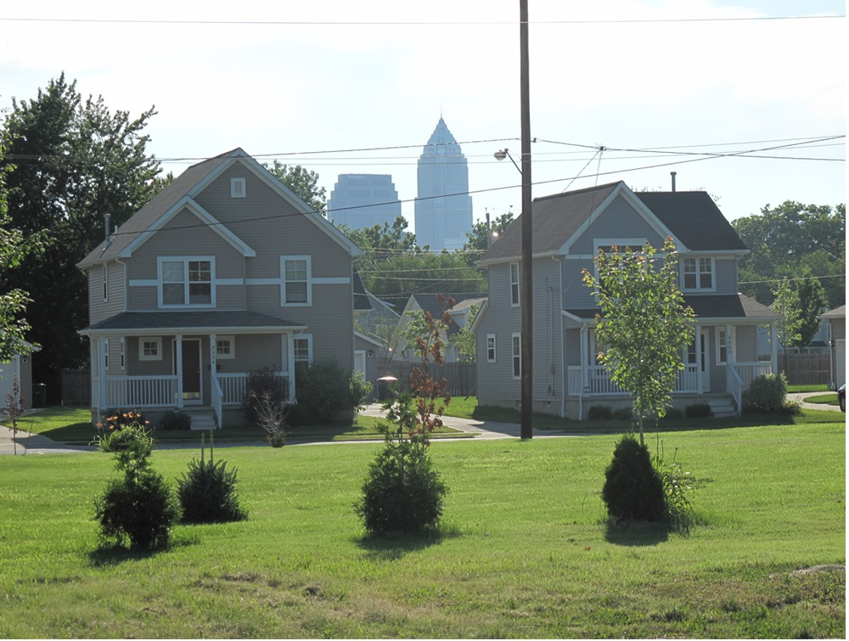
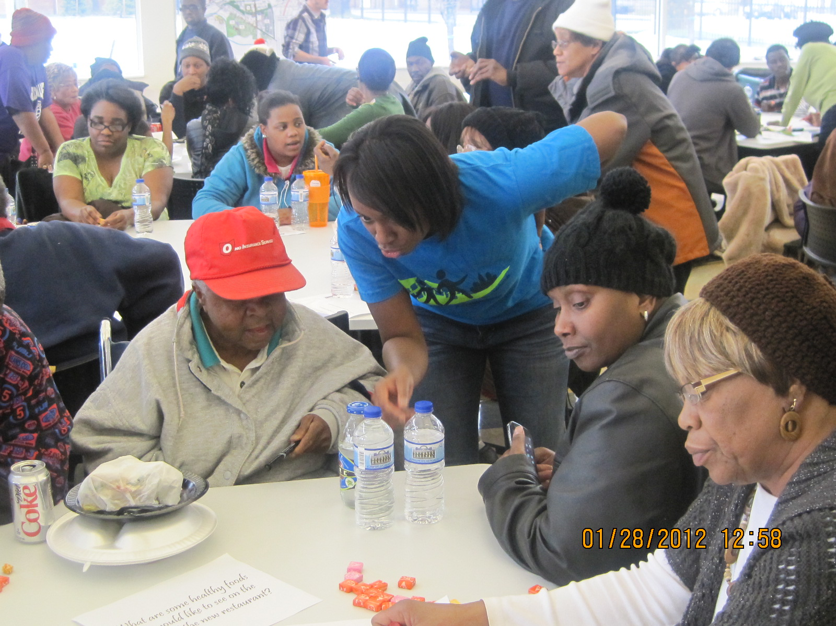
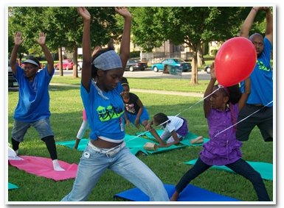
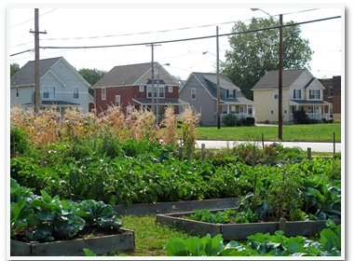
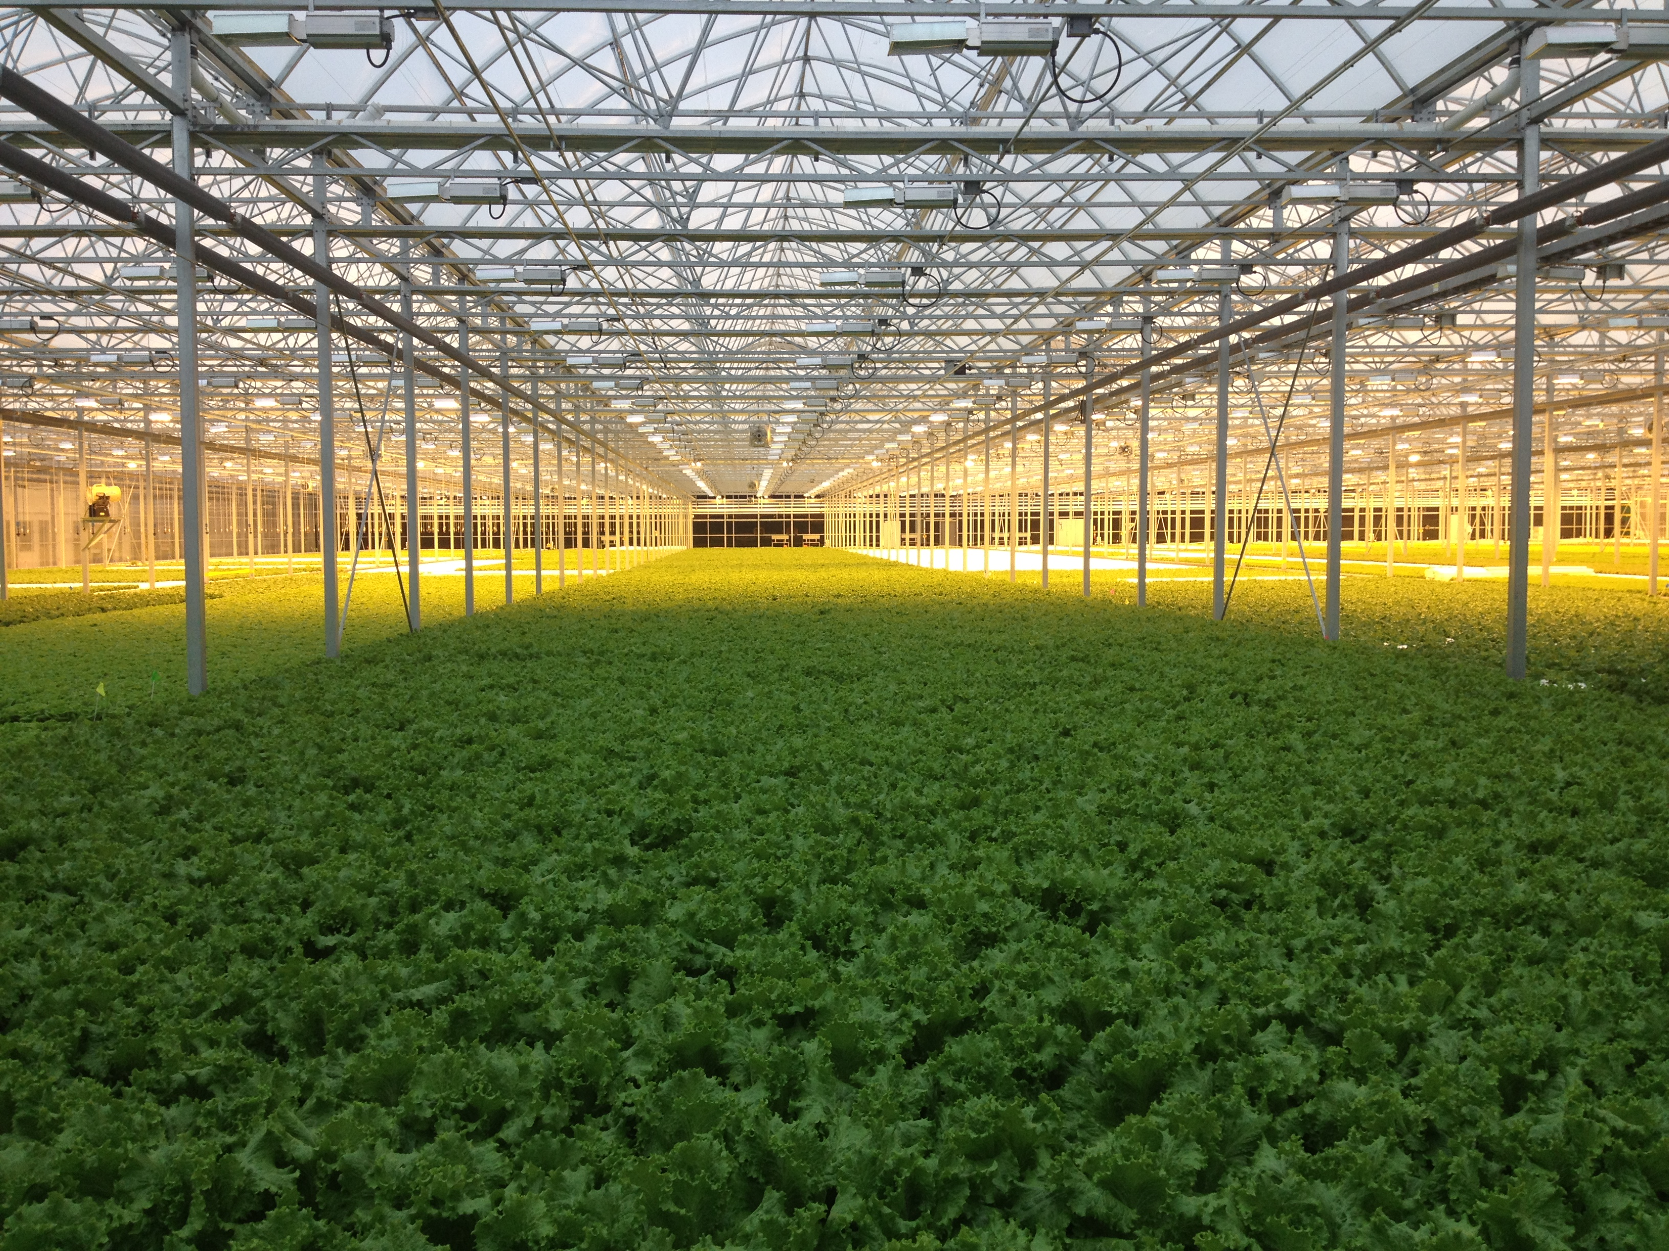
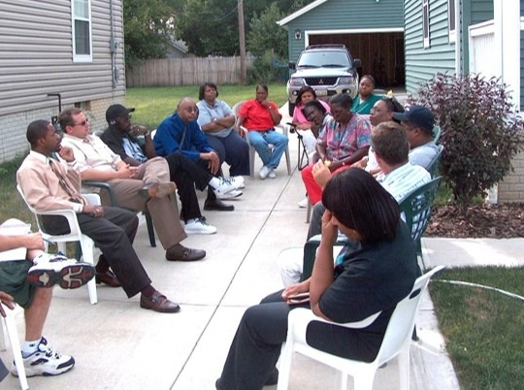

Burten, Bell, Carr Development, Inc.
Nonprofit community development corporation
  Serves Cleveland’s Central, Kinsman and Buckeye neighborhoods.
BBC’s mission is to empower citizens and revitalize blighted and underserved communities.
We revitalize communities through neighborhood planning, physical development and human development.

Slide 33
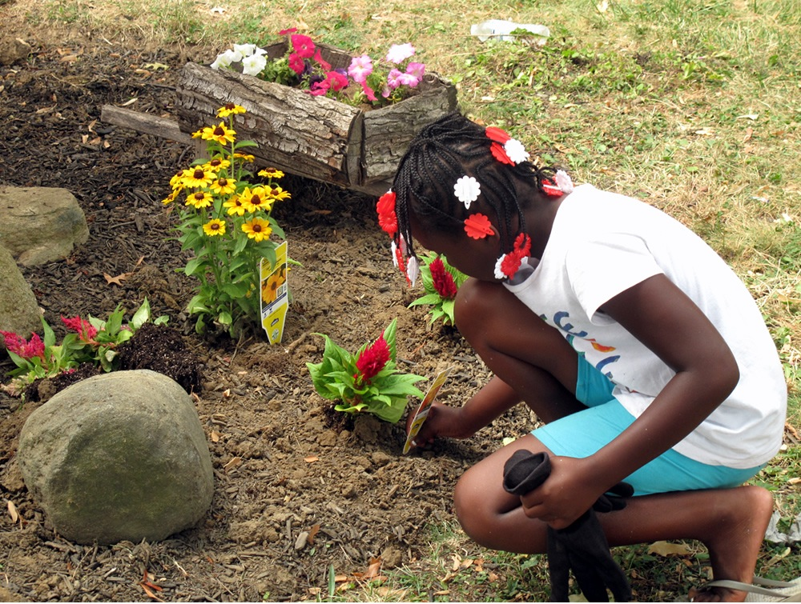
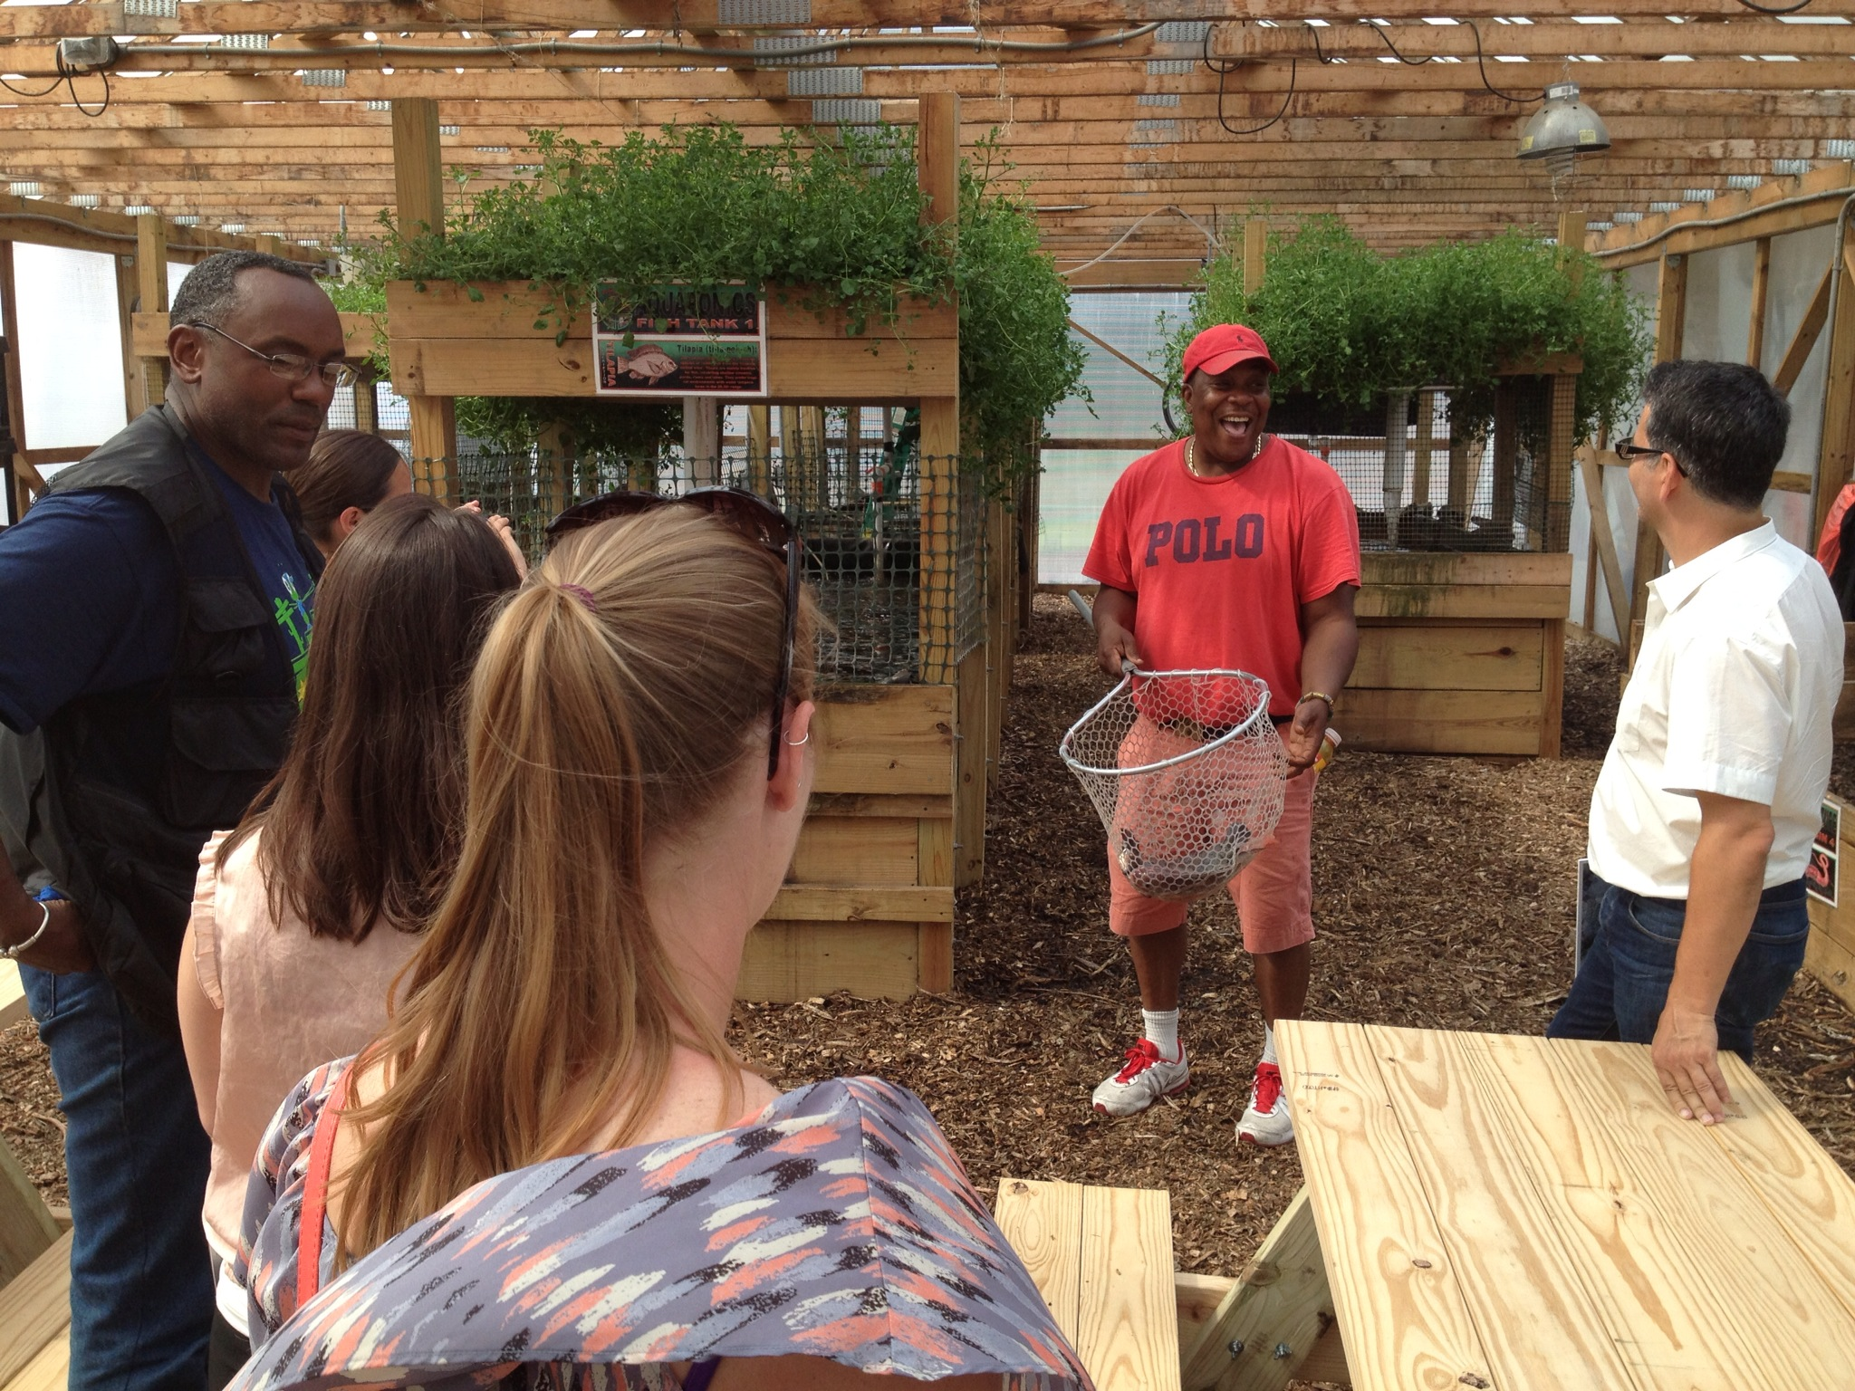
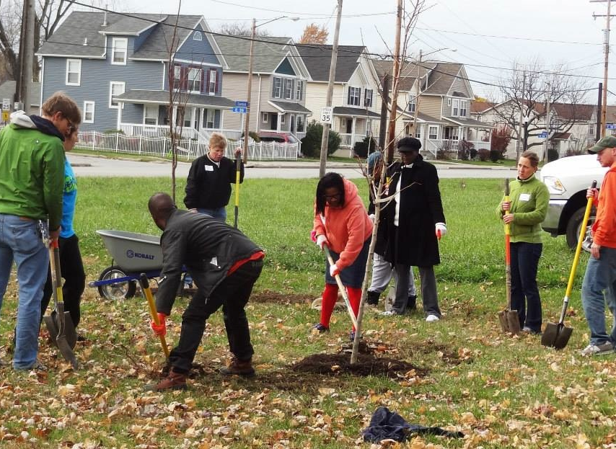
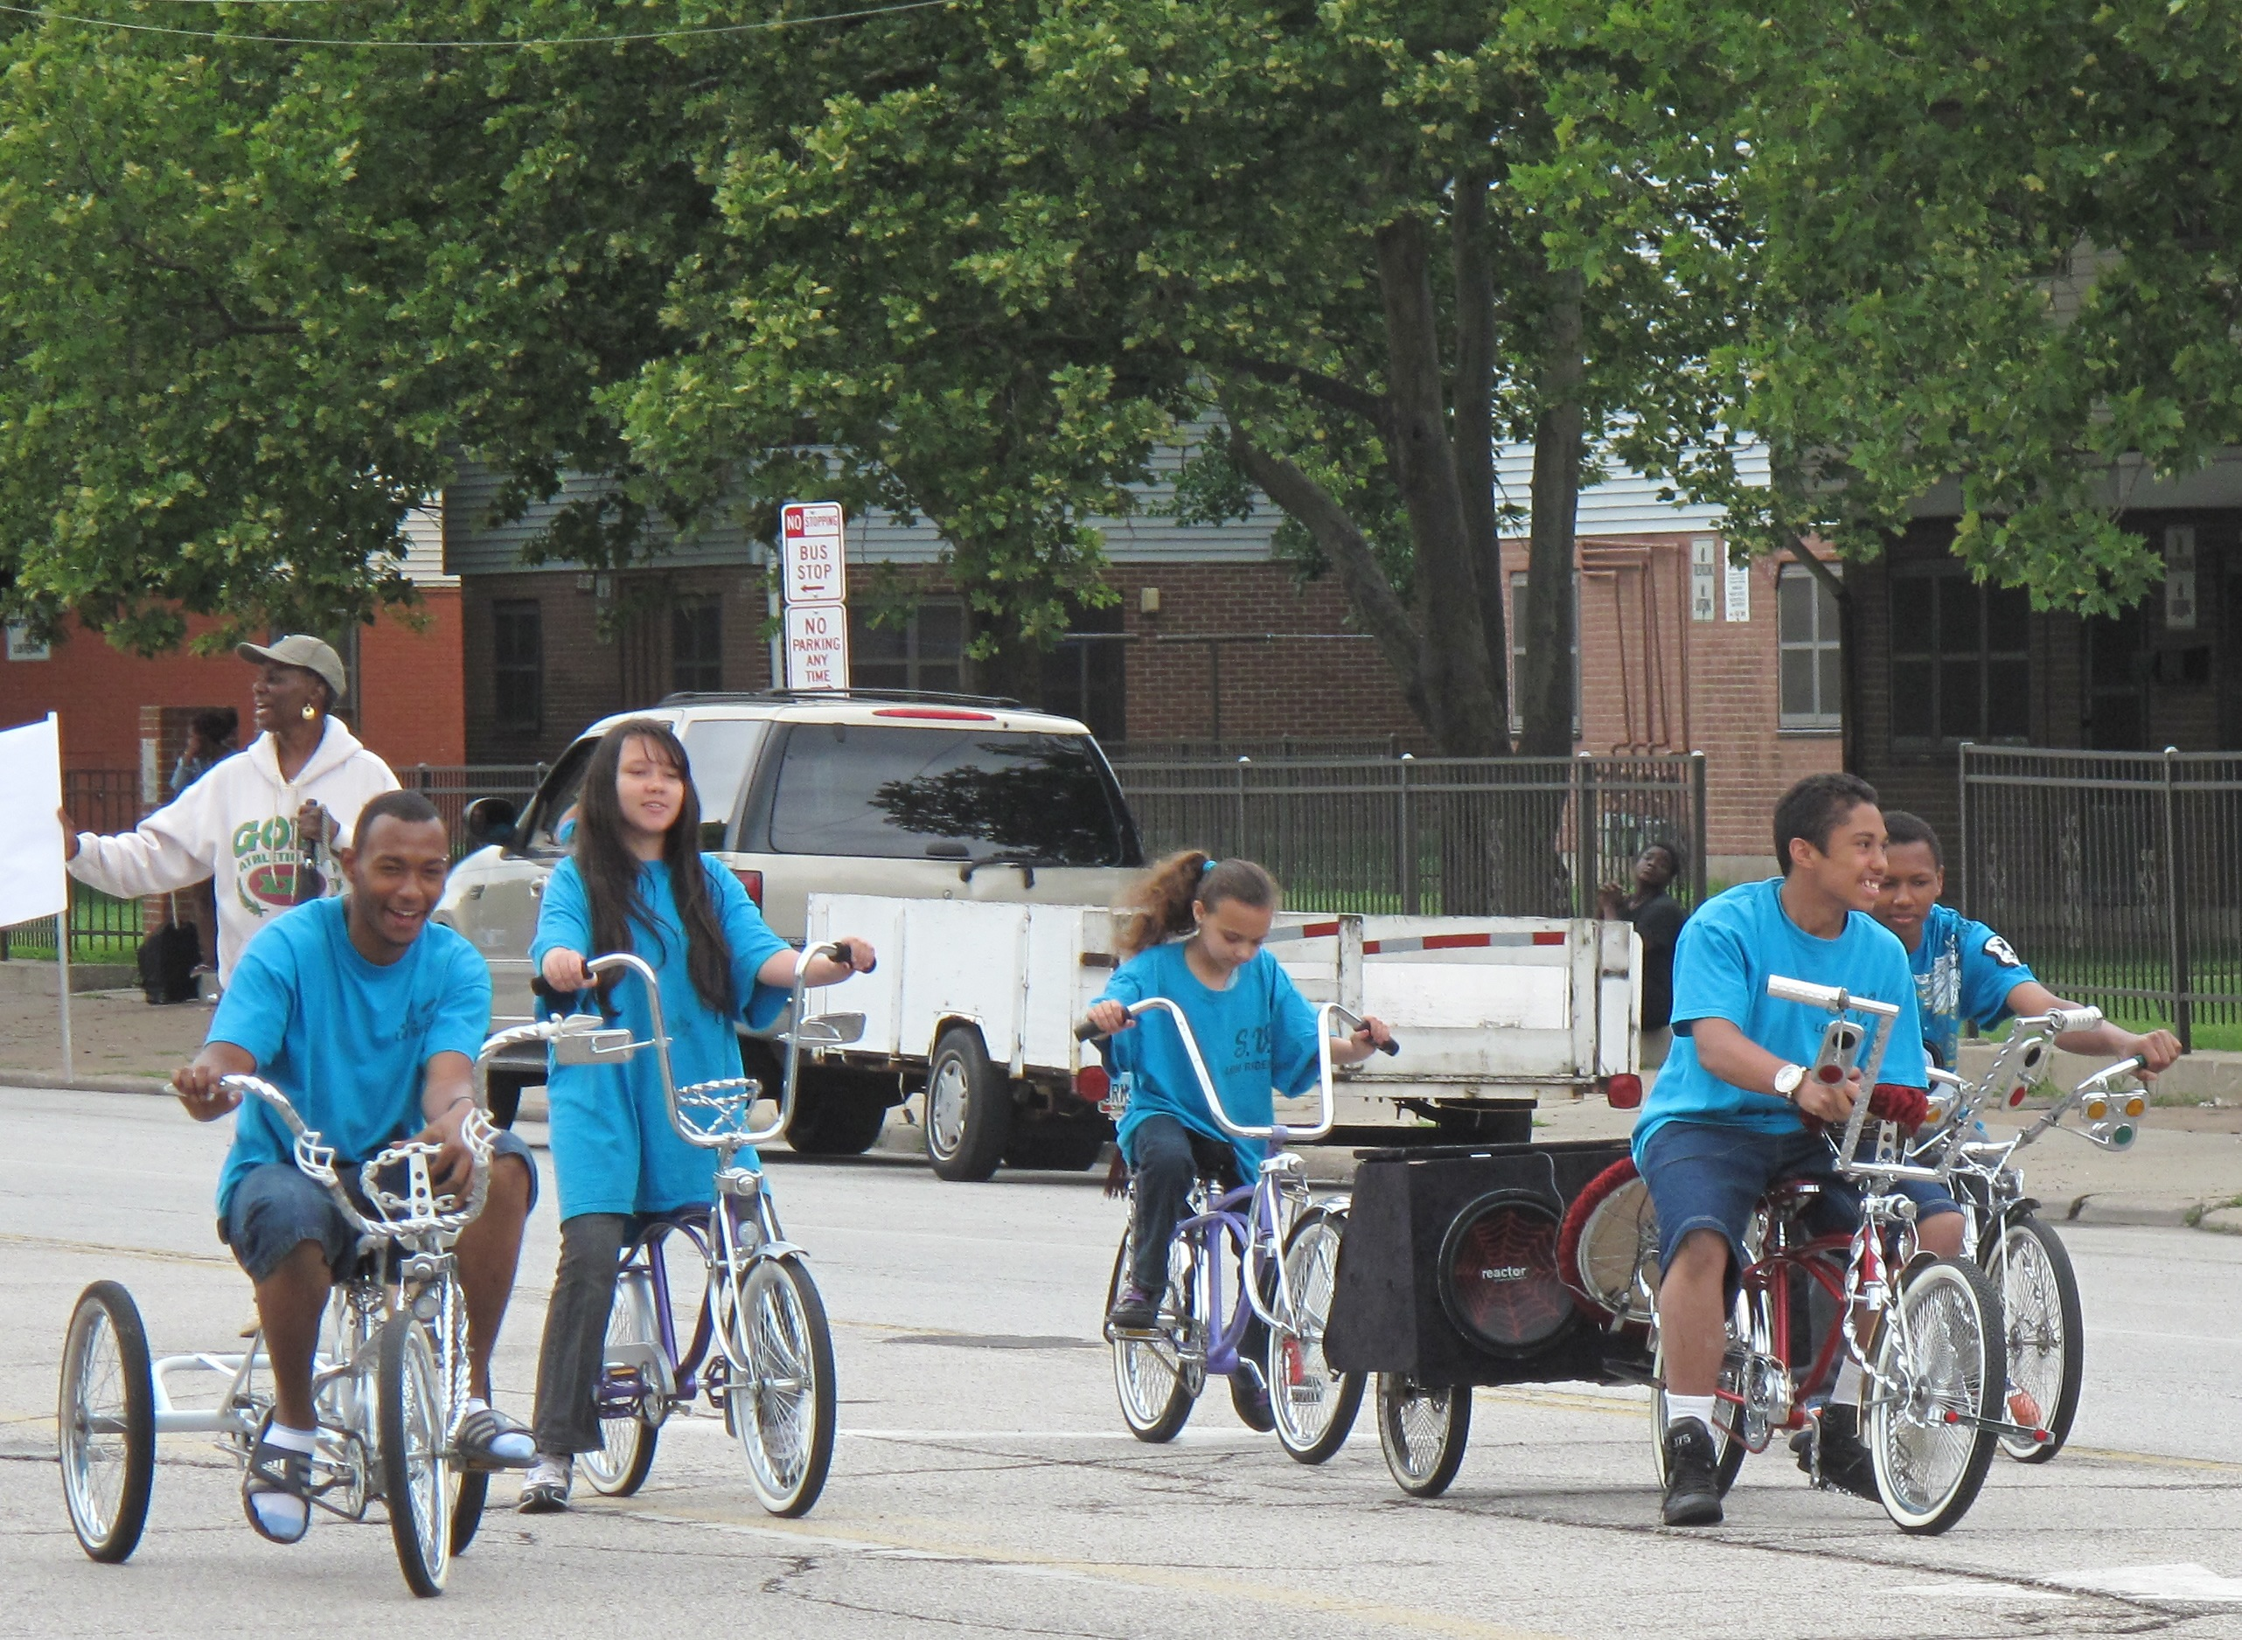
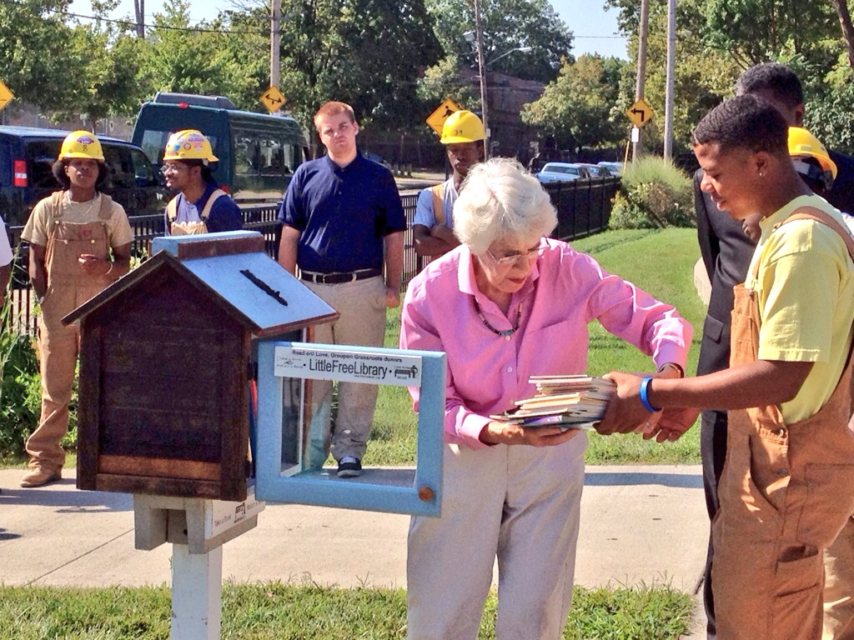
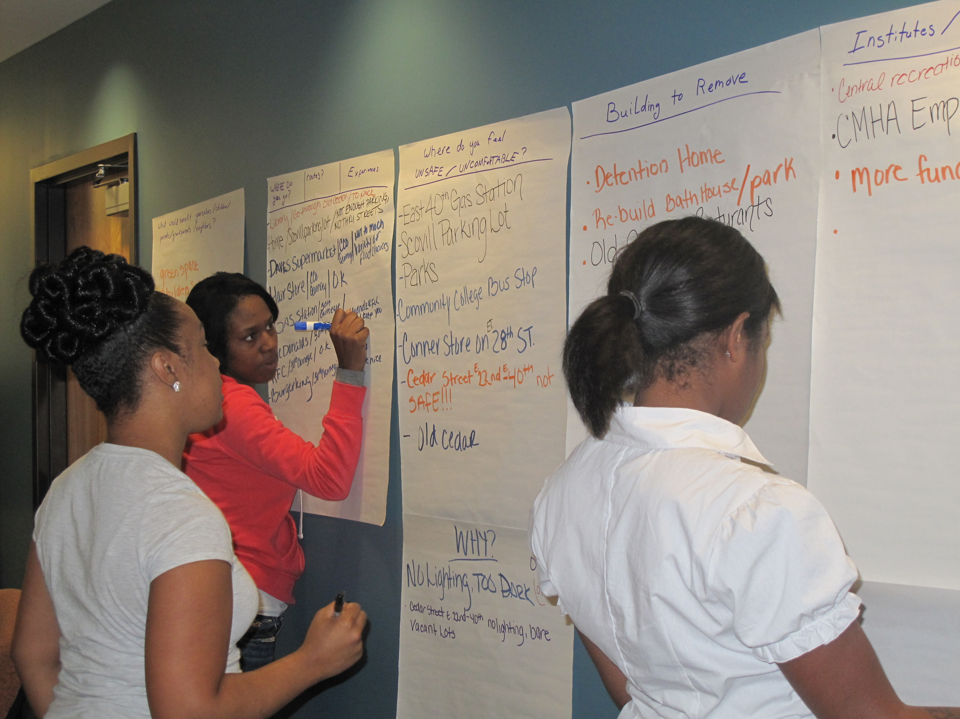
Community Engagement is Key in
Community Development
Community development is a multi-layered process
Understand the landscape and challenges of each neighborhood to determine how engagement should take place
Set an environment for residents to have a sense of ownership in their community
Improving Neighborhood
Attraction & Pride
Supporting Better Land Utilization
Incorporating Impactful
Urban Amenities
Integrating Transportation
& Mobility Options
Better Aligning Education
with Community Development
Fostering Grassroots
Community Leadership

Slide 34
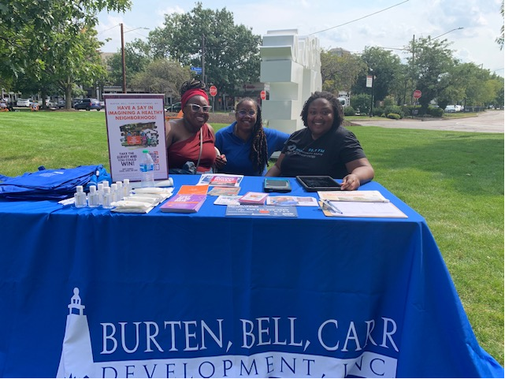
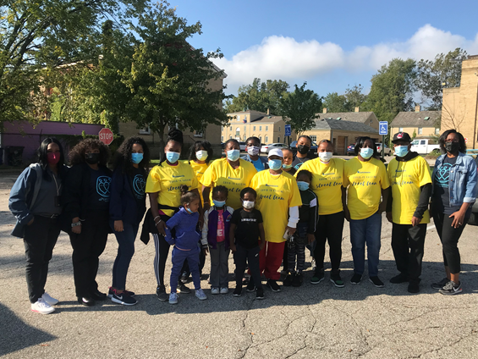
Community Health Needs Assessment
Components of our CHNA community engagement strategy:
Passive Engagement
  Social Media
  Print Media
In-Person Engagement
  Resident Involvement
  Training
  Compensation
  Technology

Slide 35

Thank You
For any questions, email smullins@bbcdevelopment.org

